Slide 1
Musculoskeletal System
Year 11 Human Biology
ATAR
PowerPoint #12

Slide 2
SCSA Syllabus Reference
the muscular system is organised to maintain posture and produce movement; muscle fibre contraction can be explained using the sliding filament theory
movement results from the actions of paired muscles, with others acting as stabilisers, to produce the required movement
the skeletal framework of the body consists of bone and cartilage which function to provide body support, protection and movement, and is facilitated by the structure and function at cell and tissue levels
articulations of joints of the skeleton are classified according to their structure or the range of movements permitted

Slide 3
Lesson Intention
To explore the structure of skeletal muscle
To explore the sliding filament theory
To explore how skeletal muscles work together
To explore the skeletal system
To explore the structure of bone and cartilage
To explore the movement of bones
To explore the effects of ageing on the musculoskeletal system

Slide 4
Success Criteria
recall the different types of muscles
describe the structure of skeletal muscle
describe the structure of skeletal muscle fibres
describe the structure of myofibrils
describe how muscles work
explain the sliding filament theory
construct a diagram of the sliding filament theory (fig 8.9 pg 199)
describe how skeletal muscles work together to achieve movement
distinguish between antagonists, synergists and agonists

Slide 5
Success Criteria
explain the relationship between muscle tone and posture
describe the function of the skeleton
recognise different types of bones and their functions
distinguish between the axial and appendicular skeleton
describe the macroscopic structure of long bones
describe the microscopic structure of bones
distinguish between compact and spongy bone
distinguish between the three types of cartilage

Slide 6
Success Criteria
describe how joints are classified
distinguish between the different types of joints
give examples of the different types of joints and their locations in the human body
describe different movements that can occur at a joint
describe the effects of osteoarthritis
describe the effects of osteoporosis
explain the causes of these conditions
describe management and prevention techniques

Slide 7
Vocabulary
Muscle fibre: the long cylindrical cells that make up skeletal muscle
Sarcolemma: a thin, transparent membrane surrounding a muscle cell
Sarcoplasm: the cytoplasm of striated muscle fibres
Myofibril: a thread-like structure found in the cytoplasm of muscle fibres

Slide 8
Vocabulary
Myofilaments: one of the structures that make up the myofibrils of skeletal muscle fibres
Myosin: one of the contractile proteins of skeletal muscle; makes up the thick myofilament of a myofibril
Actin: one of the contractile proteins of skeletal muscle; makes up the thin myofilaments of a myofibril
Sarcomeres: the contractile unit of skeletal muscle; consists of actin and myosin filaments

Slide 9
Vocabulary
Sliding filament theory: the theory used to explain muscle contractions.
Tendon: fibrous tissue that attaches muscle to bone
Antagonist: muscle that has an action opposite to that of the agonist
Origin: the end of a muscle that is fixed to the stationary bone

Slide 10
Vocabulary
Insertion: the end of a muscle fixed to the movable bone
Agonist: muscle that causes the desired action; often referred to as the prime mover
Synergist: a muscle that acts indirectly in steadying a joint during a particular movement
Fixator: a muscle that contracts to immobilise a joint

Slide 11
Vocabulary
Muscle tone: partial contraction of skeletal muscle
Articulation: the connection between two bones
Axial skeleton: the part of the skeleton that forms the central axis of the body. It consists of the skull, vertebral column, ribs and sternum
Appendicular skeleton: the part of the skeleton made up of the bones of the upper and lower limbs, and the bones of the shoulder and pelvis

Slide 12
Vocabulary
Diaphysis: the shaft of a long bone
Epiphysis: the end of a long bone
Cancellous bone: bone that contains many large spaces; appear spongy
Periosteum: the dense, fibrous outer covering of a bone

Slide 13
Vocabulary
Osteons: the basic unit of structure of compact bone; consists of a central canal surrounded by concentric layers of hard matrix and bone cells
Lamellae: concentric rings that make up compact bone
Lacunae: space in the matrix of bone or cartilage occupied by a cell
Osteocyte: a mature bone cell

Slide 14
Vocabulary
Canaliculi: small canals in the matrix of bone; joins the spaces that contain bone cells
Trabeculae: bony plates that criss-cross with many others to make up spongy bone
Hyaline cartilage: flexible supporting cartilage
Elastic cartilage: cartilage that contains elastic fibres

Slide 15
Vocabulary
Fibrocartilage: a type of cartilage that contains bundles of fibres
Joint: the connection between two bones
Fibrous joint: a joint at which no movement occurs between the bones; the bones are held in place by fibrous tissue.
Cartilaginous joint: a joint at which only limited movement occurs between the bones

Slide 16
Vocabulary
Synovial joint: a freely movable joint
Articular capsule: the sac-like envelope in the cavity of a synovial joint
Bursae: a small sac or cavity filled with fluid; found at friction points of a movable joint
Ligaments: fibrous tissue that attaches one bone to another

Slide 17
Vocabulary
Flexion: to bend
Extension: lengthening of a muscle
Abduction: movement of a limb away from the midline of the body
Adduction: movement of a limb towards the midline of the body
Rotation: movement of a bone around its long axis

Slide 18
Vocabulary
Osteoarthritis: deterioration of joint cartilage due to age or injury, to the point where the bone surfaces are not protected
Osteoporosis: reduced bone density due to ageing, resulting in increased risk of fractures.

Slide 19
Types of Muscles
Three different types
Skeletal: muscles that move bones and enable us to walk, run and carry out a range of activities.
Smooth: muscles for movement not under conscious control and found in the digestive system track
Cardiac: heart muscle, unconscious control

Slide 20
Skeletal Muscle- Structure
Muscles are held together in bundles.
A sheath of connective tissue called the perimysium surrounds each bundle so that it can function as an individual unit. The connective tissue allows adjacent bundles to slide easily over one another as they contract.
Sheaths of connective tissue called epimysium hold the bundles together and towards the end of the muscle, they taper and blend to form the tendon.

Slide 21
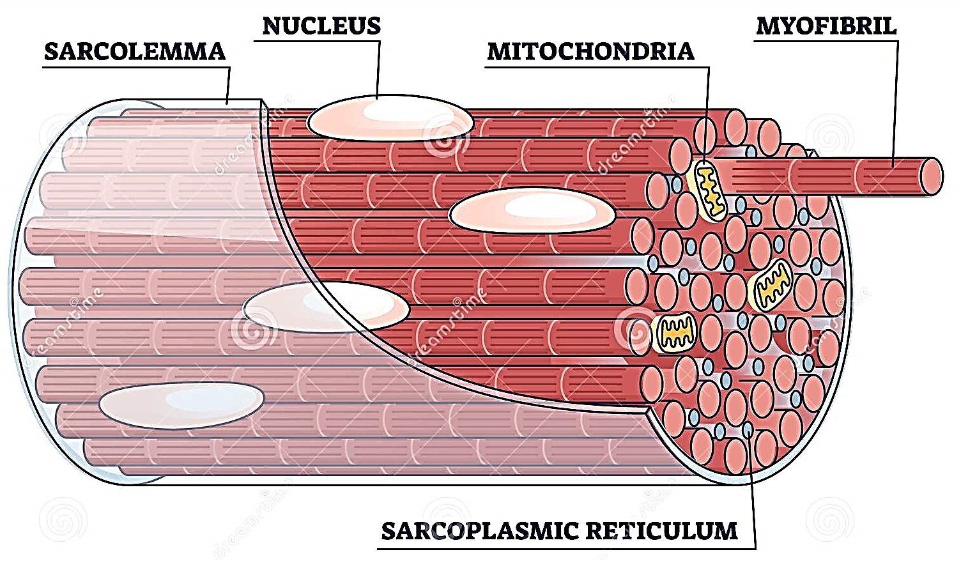
Skeletal muscle fibres- Structure
Each muscle cell, called a muscle fibre, is an elongated cylinder with many nuclei.
Around the cell is a thin, transparent plasma membrane, the sarcolemma, containing cytoplasm, called the sarcoplasm.

Slide 22
Myofibrils- Structure
Myofibrils are found within the sarcoplasm of each fibre.
A tubular network called the sarcoplasmic reticulum surrounds the myofibrils. This is a storage site for calcium ions, which are released during muscle contractions.
Each myofibril is composed of many smaller myofilaments (protein), which are responsible for the contraction of the muscle.

Slide 23
Myofibrils- Structure continued.
There are 2 types of myofilaments:
Thick myofilaments, composed mainly of the protein myosin
Thin myofilaments, composed mainly of the protein actin
When muscles are supplied/given enough energy (ATP) and has been activated by a nerve impulse, myosin and actin slide past each other, shortening the myofibril.
The arrangement of myosin and actin give the muscle a banded effect.

Slide 24
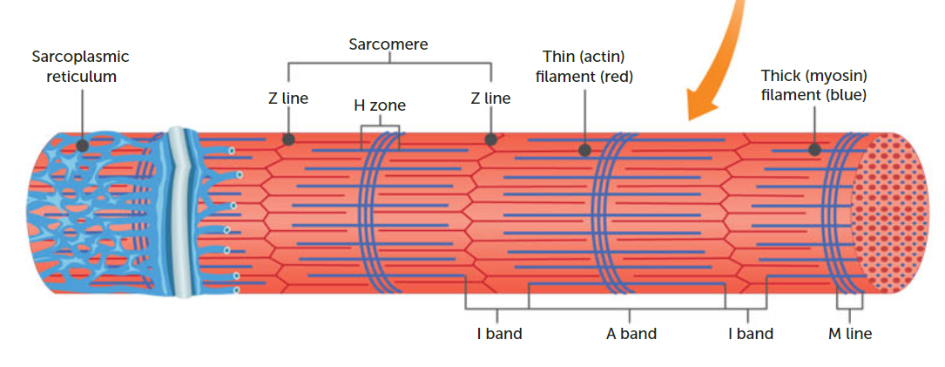

Slide 25
Key Point
Skeletal muscle is made of bundles of muscle fibres
that contain myofibrils
which contain myofilaments
made of the proteins actin and myosin

Slide 26
Sliding Filament Theory
Explains the process of muscle contraction.
When muscles contract, the sarcomere shortens because the actin and myosin filaments slide over one another.

Slide 27
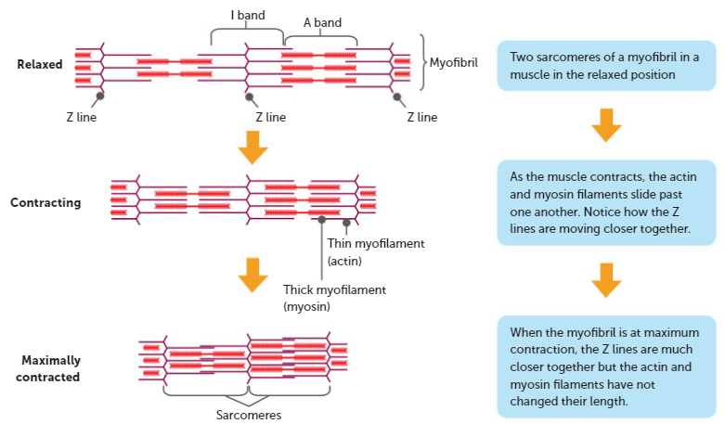

Slide 28
https://www.youtube.com/watch?v=U-yQywkad8E
https://www.youtube.com/watch?v=Ktv-CaOt6UQ

Slide 29
Sliding Filament Theory continued
Energy is required for the shortening of the muscle fibres. The energy comes from the breakdown of ATP in the muscle cells.
Muscles are attached to the bones of the skeleton by fibrous, inelastic connective tissue called tendons. They are attached to the bones in such a way that they bridge the joints, so muscle contraction causes bone movement.
Muscles can ONLY contract. Muscles are ALWAYS grouped in pairs.

Slide 30
Muscle Movement
Coordination of the grouped/paired muscles provides body movement, with one of the pair producing movement of the bones in ONE direction and the other producing movement in the OPPOSITE direction.
Such pairs of muscles are referred to as antagonists, as they have opposite actions.

Slide 31
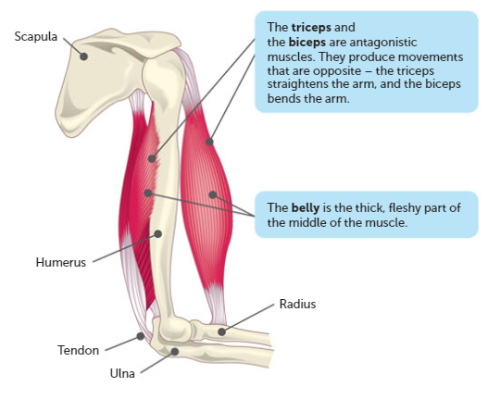

Slide 32
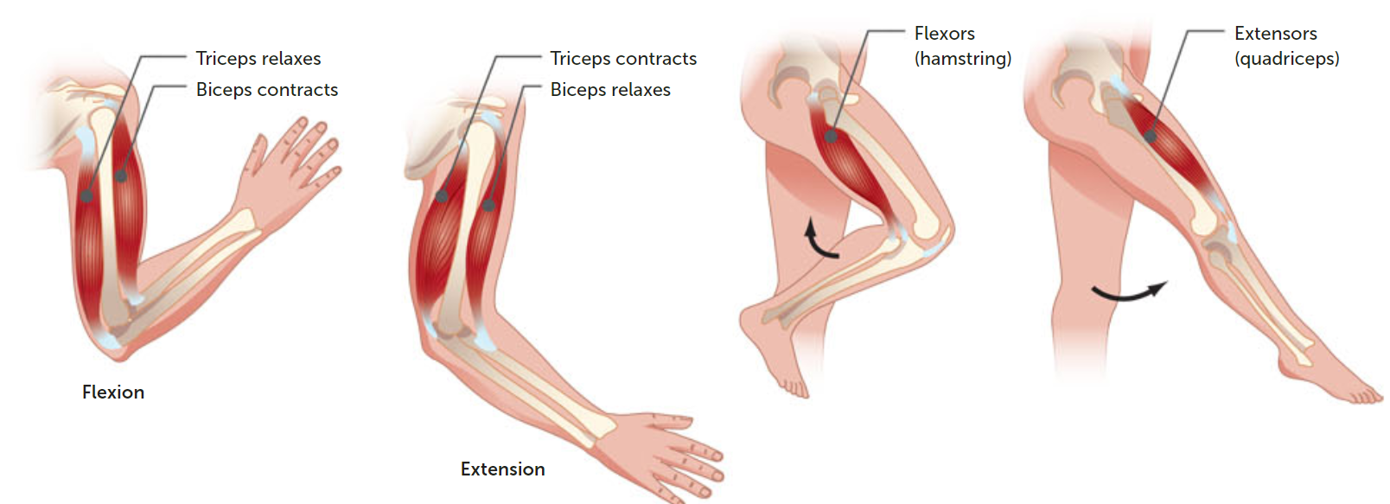

Slide 33
Muscle movement
The end of the muscle fixed to the stationary bone is called the origin.
The attachment to the movable bone of the other end of the muscle is called the insertion.
The fleshy portion of the muscle between the tendons of the origin and the insertion is called the belly.
A muscle that causes a desire action is called the agonist (prime mover)

Slide 34
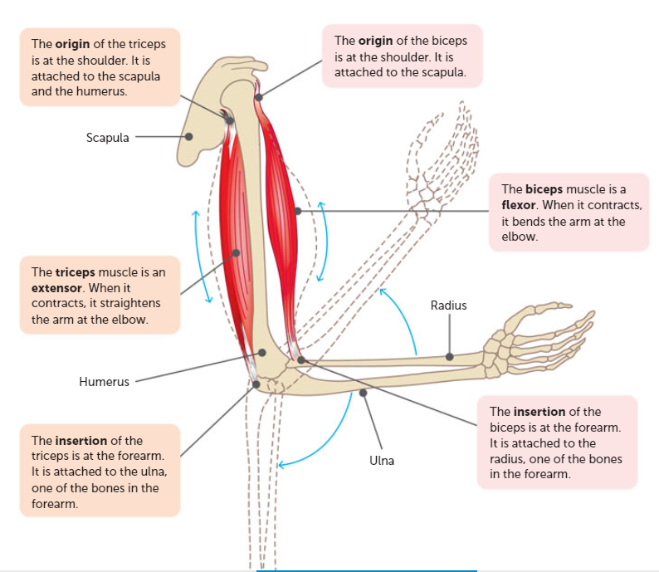

Slide 35
Synergists
Remember, muscles work in pairs, with each fulfilling opposite roles.
Synergists are muscles that help the prime mover/agonist. They either produce the same movement as the prime mover or they may steady a joint during movement. E.g. wrist/fingers/arm scenario.
When a synergist immobilises a joint, it is called a fixator. E.g. scapula held firm/ribs and muscle movement.

Slide 36
Muscle Tone
All about maintaining partial contraction of skeletal muscles.
Muscle tone hold many of our body parts in position e.g. head vertically held by neck muscles.
A person’s posture is the characteristic way they hold their body while sitting, standing and moving.

Slide 37
Skeletal System- Function
Supports the weight of the rest of the body
Facilitates movement by being points of attachment for muscles.
Protects vital internal organs
Produces red blood cells
Stores and releases minerals and fat

Slide 38
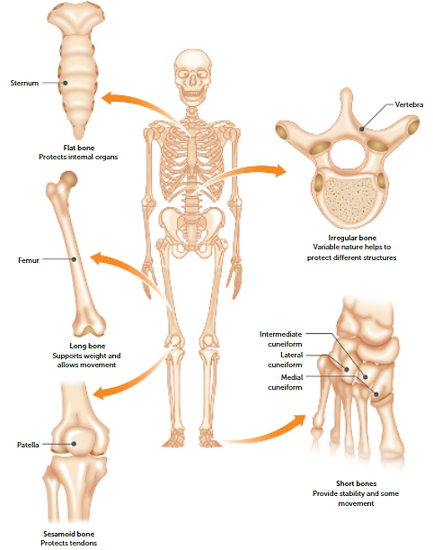
The 5 different types of bone

Slide 39
Bones of the skeleton
206 bones in total. Some are fused to each other, but most have joints between them to allow for movement
Bones are divided into 2 sections
Axial- bones around the central axis of the body. Provide main support for posture and protect the CNS
Appendicular- bones of the upper and lower limbs.

Slide 40
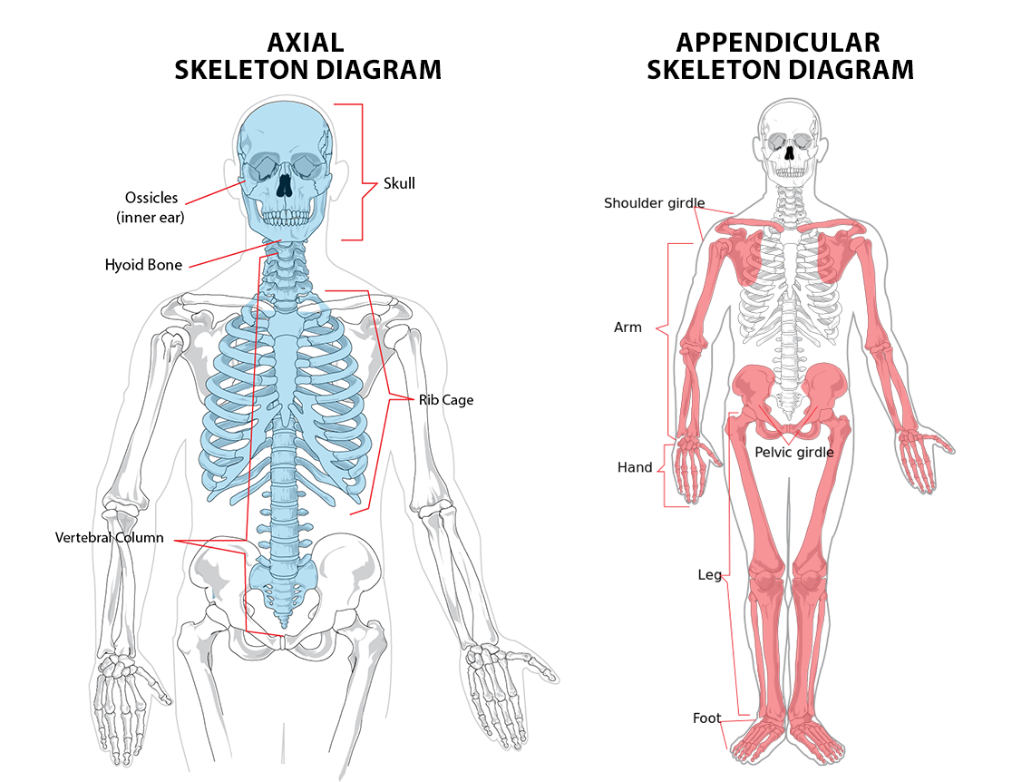

Slide 41
Macroscopic structure of long bones
A long bone consists of the following:
Diaphysis: shaft making up the main portion of the bone. When the bone is cut lengthwise, the diaphysis is seen to be a hollow cylinder of compact bone surrounding a cavity (used to store fat).
Epiphyses (single-epiphysis): enlarged end of the bone, covered by a thin layer of cartilage. Have compact bone of the outside by central regions have spongy/cancellous bone (more porous and filled with marrow).
Periosteum: the dense, white, fibrous outer covering of the bone.

Slide 42
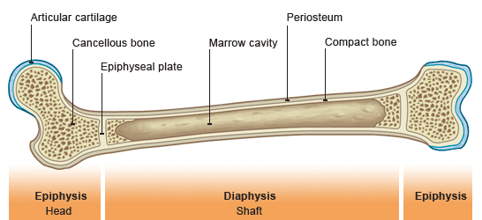

Slide 43
Microscopic structure of bone
Remember- bone is classified as connective tissue
Connective tissue consists of cells separated from each other by large amounts of non-cellular material called matrix. In bone, inorganic salts of calcium and phosphate are deposited in the matrix. These increase its rigidity and strength, making it the hardest of connective tissue.

Slide 44
Compact bone- structure
Compact bone consists of many similar structures called osteons (also called Haversian systems) that run parallel to the long axis of the bone. They are responsible for giving the bone its maximum strength.

Slide 45
Osteon
Each osteon has
A central canal at its centre
Concentric layers of bony matrix called lamellae surrounding the central canal
Lacunae, which are small spaces in the matrix
A bone cell (osteocyte) occupying each lacunae (space)
Tiny canals (canaliculi), running between the lacunae (small spaces)
Projections from the bone cells entering the canaliculi and making contact with adjacent bone cells (allowing transport between cells)
At least one blood capillary, and possibly nerves and lymph capillaries, in the central canal of each osteon.

Slide 46
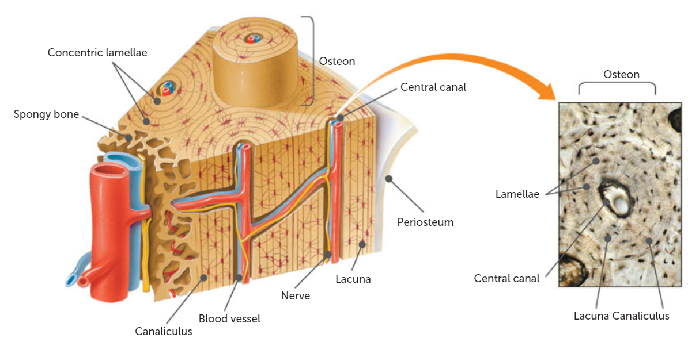

Slide 47
Spongy Bone- structure
Also called cancellous bone.
Not organised into osteons with concentric layers of lamellae. Instead, it consists of an irregular arrangement of thin, bony plates called trabeculae.
The bone cells occupy spaces in the trabeculae, and nerves and blood vessels pass through irregular spaces in the matrix.

Slide 48
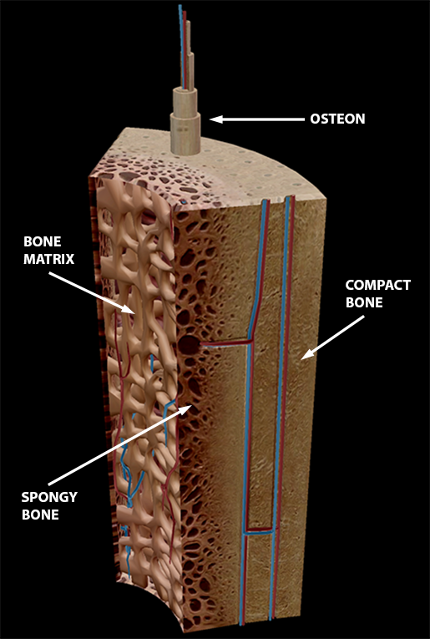

Slide 49
Cartilage- Structure
Is a connective tissue.
Contains numerous fibres made of a protein called collagen. These protein fibres are embedded in a firm matrix of a protein- carbohydrate complex called chondrin.
Chondrin is what allows cartilage to function as a structural support, whilst the fibres give it a certain amount of flexibility. E.g. ear, nose.

Slide 50
Cartilage- Structure continued.
In cartilages firm matrix, collagen fibres are embedded. The spaces within the matrix contain cartilage cells called chondroblasts.
Chondroblasts produce matrix and gradually become surrounded by it until they are trapped in small spaces called lacunae. Once this has occurred, the cells are considered to be mature and are referred to as chondrocytes.

Slide 51
Types of cartilage- Hyaline
Contains many closely packed collagenous fibres throughout the matrix. These fibres are so fine, they are not distinguishable under a light microscope.
They give the cartilage strength along with the flexibility. It makes up rings of the trachea and bronchi, and is also found in articular cartilage at the ends of bones.

Slide 52
Types of Cartilage- Elastic
Has elastic fibres. It also contains collagenous fibres similar to hyaline cartilage (but not as closely packed together).
Provides flexible elastic support in places such as the external ear.

Slide 53
Types of Cartilage- Fibrocartilage
Has a coarse appearance from the parallel bundles of thick collagenous fibres
Fibres are not compacted as much as in hyaline and therefore are slightly compressible.
Found where the weight of the body is being supported or is under heavy pressure. E.g. intervertebral discs of the spinal column.

Slide 54
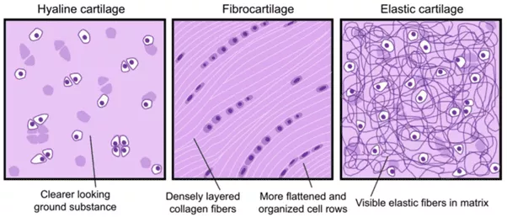

Slide 55
Cartilage- again
Does not contain blood vessels, so all nutrition and waste removal for cells depends on diffusion through the matrix.
This is a slow process and results in the chondrocytes having a slow rate of metabolism and cell division. Injured cartilage takes a long time to heal as the blood supply comes from the perichondrium (fibrous connective tissue membrane that covers cartilage).

Slide 56
Movement of bones
The site at which two or more bones come together is called a joint.
Joints are classified according to:
Their range of movement
The type of connective tissue that binds the bones together

Slide 57
Fibrous or fixed joints
When no movement occurs between the bones
Held in place by fibrous connective tissue
E.g. sutures of the skull

Slide 58
Cartilaginous or slightly movable joints
Are held in place by cartilage, which allows slight movement to occur.
E.g. the junction of the two pelvic bones

Slide 59
Synovial or freely movable joints
Most joints of the body are freely movable, with the amount of movement limited by ligaments, muscles, tendons and adjoining bones.
Occur at the shoulder, elbow, wrist, finger, hip, knee, ankle and toes.
They are also the most commonly injured joints in sporting and other accidents.
There are many different categories of synovial joints.

Slide 60
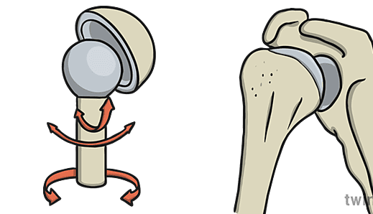
Synovial- Ball and socket joints
Form when the spherical head of one bones fits into a cup like cavity of another. There are two such joints in the human body: the head of the humerus (upper arm bone) fits into a depression in the scapula (shoulder blade); and the head of the femur (thigh bone) articulates with the pelvis.

Slide 61
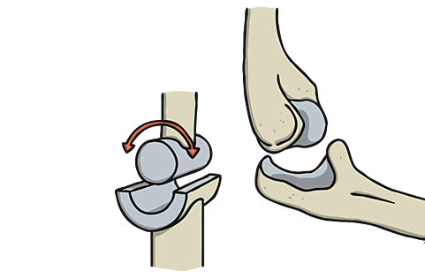
Synovial- Hinge joints
Allows movement in one plane only, much like that of a hinged door. They form when the convex surface of one bone fits into the concave surface of another. The best examples of this type of joint are the elbow and the knee, but it also occurs at the ankle, and between the ones of the fingers and toes.

Slide 62
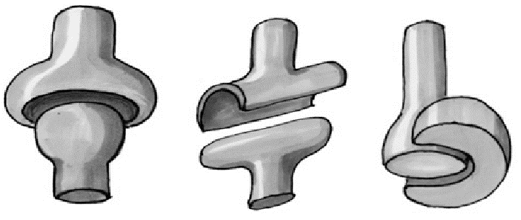
Synovial- Pivot joints
Are formed when the rounded, pointed or conical end of one bone articulates with a ring, formed partly by bone and partly by ligament. The best example is the joint between the first vertebra, on which the head is balanced (the atlas) and the second vertebra (the axis). This allows the head to rotate.

Slide 63
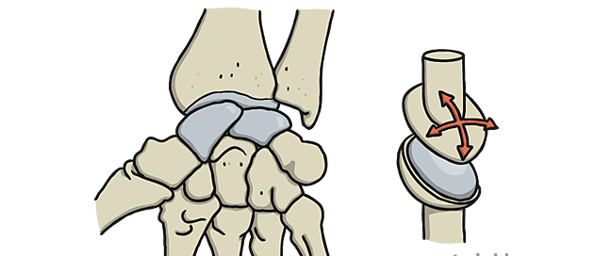
Synovial- gliding joints
Allows movement in any direction in a side-to-side or back-and-forth motion, restricted only by the ligaments or bony process surrounding the joints. Gliding joints are found between carpal bones, tarsal bones, the sternum and clavicle, and the scapula and clavicle.

Slide 64
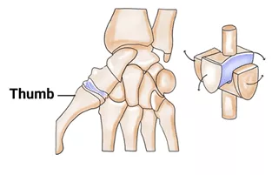
Synovial- Saddle joint
In the body where the thumb joins the palm of the hand. The two bones forming the joint are both saddle-shaped- that is, concave in one direction and convex in the other. They fit together in such a way they allow for side to side and back and forth movements.

Slide 65
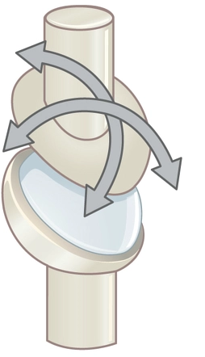
Synovial- Condyloid joints
Have one surface of bone slightly convex that fits into a slightly concave depression in another bone. Such joints occur between the radius and the carpal bones, the metacarpal bones and the phalanges of the fingers, and between the metatarsal bones and the phalanges of the toes. They allow movement in two directions, such as up and down and side to side.

Slide 66
Structure of a synovial joint
Freely movable joints are also called synovial joints because there is a space, or synovial cavity between the articulating surfaces of the bones. A synovial membrane surrounds the synovial cavity, and there is articular cartilage on the bone surfaces.
There are many following parts of this joint.

Slide 67
Structure continued.
Articular capsule surrounds and encloses the joint.
The fibrous capsule is the outer layer, consisting of dense, fibrous connective tissue
The synovial membrane is the inner layer consisting of loose connective tissue well supplied with blood capillaries.
Synovial fluid, lubricates the joint
Articular cartilage covers the articulating surfaces of the bones forming the joint.

Slide 68
Structure continued.
Articular discs occur in some synovial joints (knees) consisting of fibrocartilage that divides the synovial cavity into two, directing the fluid to where friction is greatest.
Bursae (little sacs of synovial fluid) are found in some joints, they prevent friction.
Ligaments hold the bones together in may joints e.g. ligaments in the knee.

Slide 69
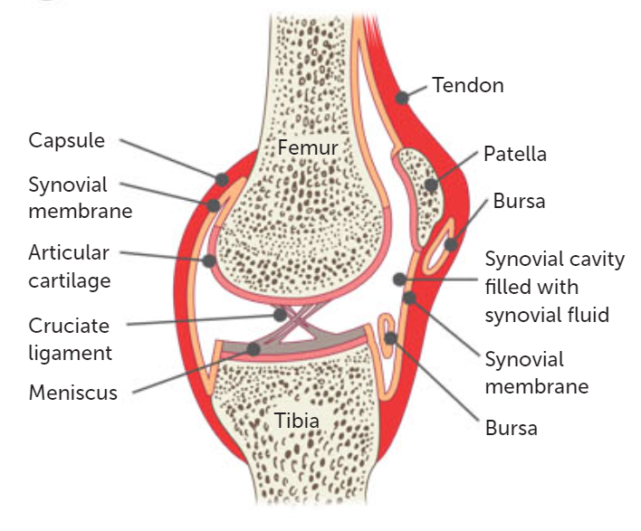

Slide 70
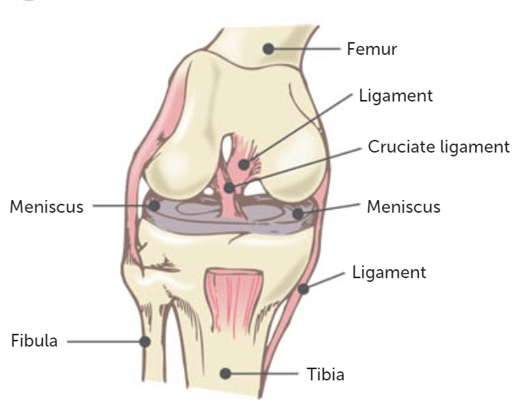

Slide 71
Movement at a joint
Flexion and extension:
Flexion (bending) decreases the angle between the articulating bones (come closer together).
Extension (straightening) increases the angle between the articulating bones (move further apart).
Abduction and adduction:
Abduction is movement away from the midline of the body
Adduction is movement towards the midline of the body
Rotation is the movement of a bone around its long axis

Slide 72
Osteoporosis
The loss of bone mass becomes sufficient to impair normal function
As bone density decreases, the risk of fractures/damage increases. Bones most likely to be affected are vertebrae, ribs, pelvis, wrist and arms.
To prevent this, you need adequate calcium, vitamin D, exercise, to stop smoking and possibly medication.

Slide 73
Osteoarthritis
Gradual change in the joints that occurs over time and is frequently associated with ageing. Other factors (irritation, wear, abrasion) also contribute.
Joint cartilage deteriorates and so the bone is exposed and begins to wear away. This usually occurs when you are middle aged.
No cure, treatment includes medication, physiotherapy and surgery.

Slide 74
Recall Knowledge
What holds bundles of muscle cells together?
What is a sarcolemma?
Describe the importance of synergists.
Describe the structure of an osteon.
Describe the function of synovial fluid

Slide 75
Apply Knowledge
Explain what happens to each of the following when a muscle contracts
The A band
The I band
The sarcomere
Explain the difference between a chondroblasts and a chondrocyte.
Describe the difference between a tendon and a ligament

Slide 76
Homework
Explain why osteoporosis often leads to bone fractures and pain.

Slide 77
Reading
Pages 193- 218: The musculoskeletal system allows movement

